Slide 1


A View on Some Laws and Principles in Computer Science: Are They Really Laws?

Slide 2

Contents
A Recap on Scientific Laws
Moore’s Law
Shannon Information Theory
Landauer’s Principle

Slide 3

A Recap on Scientific Laws
Laws as Regularities
It is a mistake to assume that law-like behavior is caused by anything. (David Hume’s Opinion)
Fail to distinguish between accidental and law-like regularity
Fail to identify the direction of causal dependency
Suffer from exceptionlessness: most of the claims that are taken to be scientific laws do not qualify
Not able to vindicate the validity of a law beyond the experimental domain

Slide 4
A Recap on Scientific Laws
Laws as Tendencies or Dispositions
Events happen because things in the world possess the tendency or disposition (or power, or capacity) to behave in the way they do. (Chalmers’ Suggestion)

Slide 5

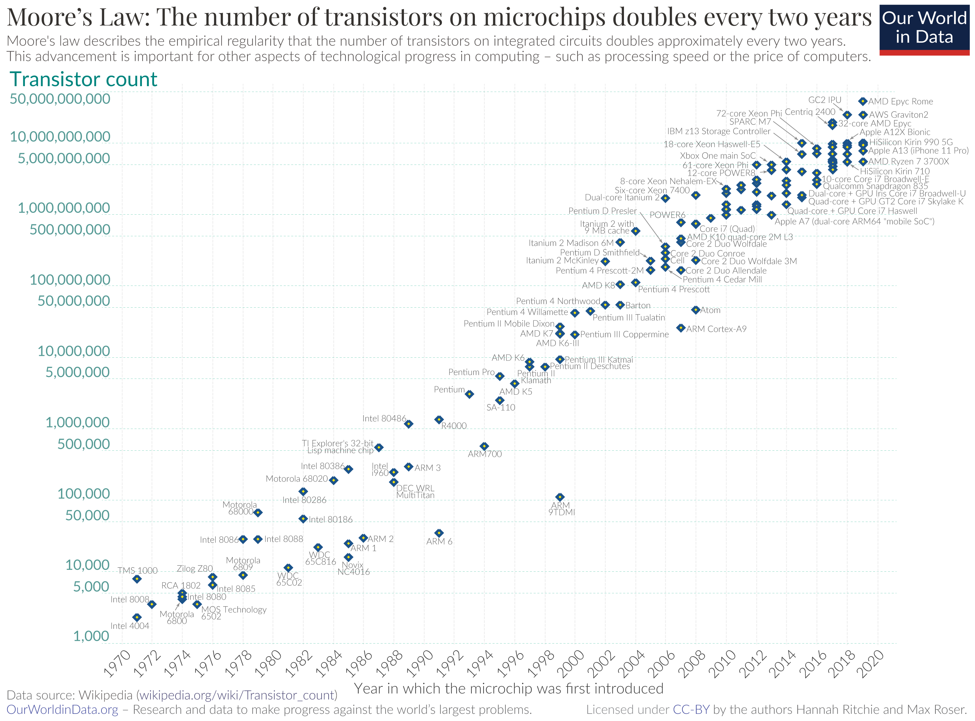
Moore’s Law
Moore's law is the observation that the number of transistors in an integrated circuit (IC) doubles about every two years.

Slide 6
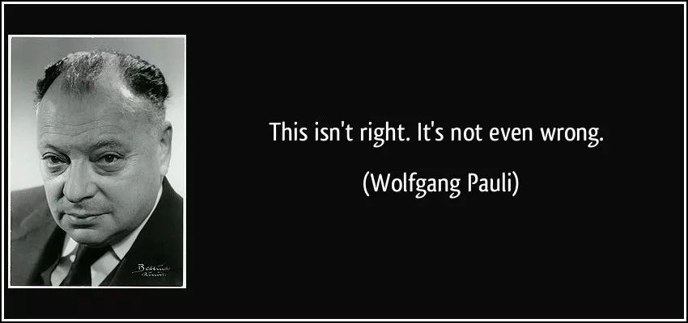
Moore’s Law
Moore's law is a product of inductivism.
It has guided the development of IC Industry for quite a long time. Nevertheless, it’s not a scientific law.
Though not even wrong, there is no causal dependency between Moore’s Law and the development of IC Industry.

Slide 7

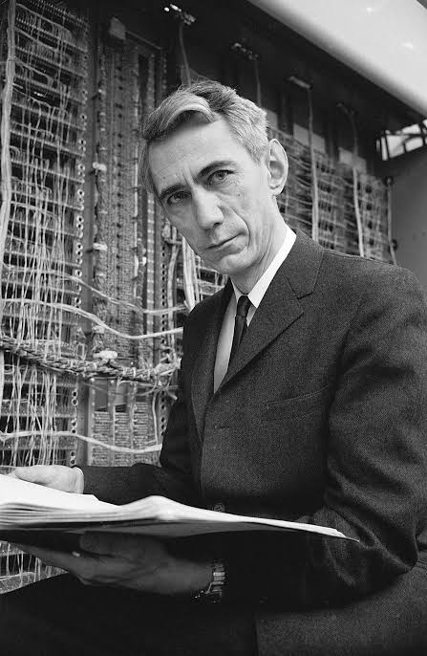
Shannon Information Theory
Information theory is the mathematical study of the quantification, storage, and communication of information.
The field was established and put on a firm footing by Claude Shannon in the 1940s.
It is at the intersection of electronic engineering, mathematics, statistics, computer science, neurobiology, physics, and electrical engineering.

Slide 8

Shannon Information Theory
A key measure in information theory is entropy, which measures the level of disorder in the probability distribution of a system.
The more uniform the probabilities, the higher the uncertainty and the greater the entropy.
The formula of the entropy is:
$$H=−\sum_{i}{P\left(x_{i}\right)logP(x_{i})}$$
where P(x_{i}) is the probability of event x_{i}.

Slide 9


Shannon Information Theory
There is also entropy in Thermodynamics, which describes the degree of disorder in a system and the probability distribution of its thermodynamic states. It is defined as follows:
$$S=k_{B}lnΩ$$
where k_{B} represents Boltzmann constant, and Ω is the number of microstates in the system, which represents the possible microscopic arrangements corresponding to a given macroscopic state.
Tenet by Christopher Nolan, a sci-fi about entropy in Thermodynamics.

Slide 10

Shannon Information Theory
Information entropy can be seen as a generalized definition of entropy.
Thermodynamic entropy can be considered a specific application of information entropy in physical systems, describing the degree of disorder in the probability distribution of microscopic states.
Thermodynamic entropy S can be expressed in the form of information entropy as follows:
$$S=−k_{B}\sum_{i}{P_{i}lnP_{i}}$$
where P_{i} is the probability distribution of the system's microscopic states.

Slide 11
Shannon Information Theory
Shannon Information Theory is a scientific law, for it describes the tendencies of every aspect of information.
Both information entropy and thermodynamic entropy are describing the disorder and uncertainty of a system, quantifying some kind of dispositions in their own fields.
There are indeed some direct connections between information and energy, which we’ll see next.

Slide 12

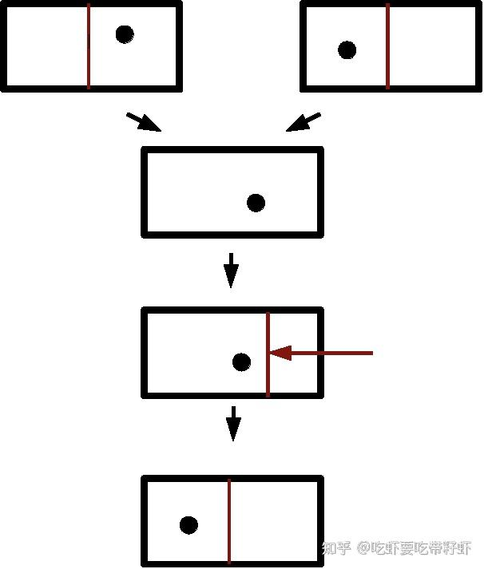
Landauer’s Principle
Landauer's principle is a physical principle pertaining to the lower theoretical limit of energy consumption of computation.
It holds that an irreversible change in information stored in a computer, such as merging two computational paths, dissipates a minimum amount of heat to its surroundings.

Slide 13

Landauer’s Principle
Landauer's principle states that the minimum energy needed to erase one bit of information is proportional to the temperature at which the system is operating.
Specifically, the minimum energy needed for this computational task is given by:
$$E=k_{B}Tln2$$
where T represents the temperature in Kelvins of the operating environment.

Slide 14
Landauer’s Principle
Landauer's principle establishes a direct connection between information entropy and thermodynamic entropy.
It is derived from the laws of thermodynamics, thus is a scientific law.
Recent research in 2018 has extended the validity of the principle to quantum realm, demonstrating its correctness.
This scientific law is a description of a kind of tendency.

Slide 15


